Slide 1

COMPUTER NETWORKS
(BCSC 0008)
Copyright content, use only with the written permission of presenter mentioned
Lecture 21

Slide 2
Text and Reference Books
Text Books:
Fourouzan B. A. (2004), “Data Communication and Networking”, 4th Edition, McGraw-Hill.
References:
Kurose, J. F. and Ross K. W. (2005), “Computer Networking: A Top-Down Approach Featuring the Internet”, 3rd Edition, Addison-Wesley.
A. S. Tanenbaum (2006), “Computer Networks”, 2nd Edition, Prentice Hall India.

Slide 3
14.5 OSPF
The Open Shortest Path First (OSPF) protocol is an intradomain routing protocol based on link state routing. Its domain is also an autonomous system.
The topics discussed in this section include:
Areas
Metric
Types of Links
Graphical Representation
OSPF Packets
Link State Update Packet
Other Packets
Encapsulation

Slide 4
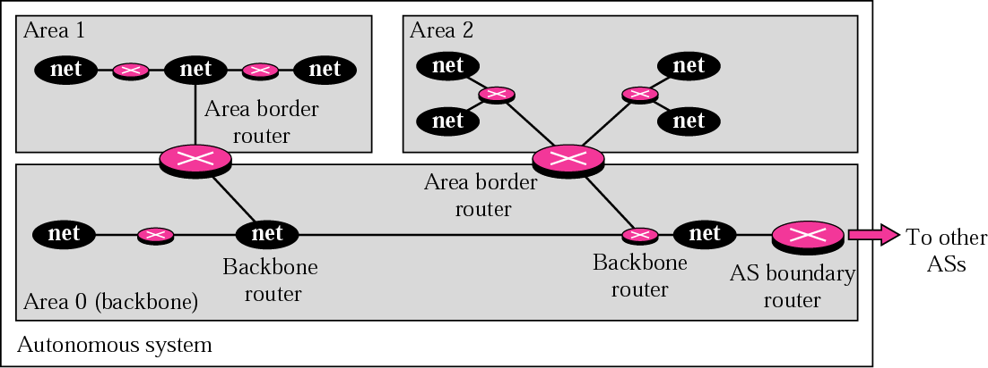
Figure 14.19 Areas in an autonomous system
OSPF divides an autonomous system into areas. All networks
inside an area must be connected.
area border router; backbones; backbone routers;
boundary routers
The cost associated with a route is called the metric. Metric
could be min delay, max thruput, etc.

Slide 5
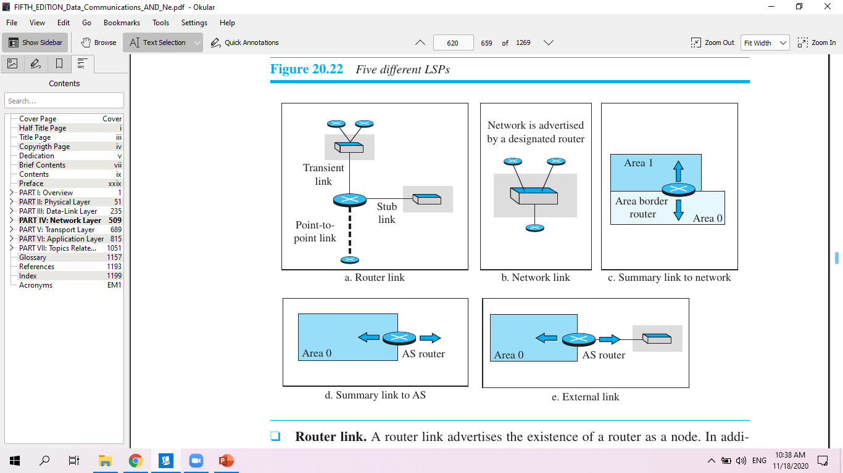
LSPs (Link State Packets)

Slide 6
LSPs
1. Router Link: A router link advertises the existence of a router as a node. In addition to giving the address of the announcing router, this type of advertisement can define one or more types of links that connect the advertising router to other entities.

Slide 7
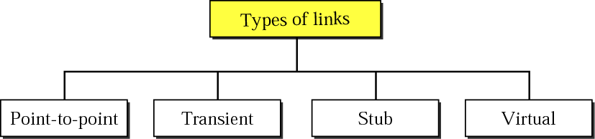
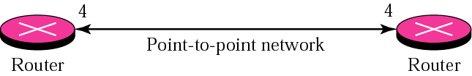
Figure 14.21 Point-to-point link
No hosts in between; T-1 connection common

Slide 8
Types of link
A transient link announces a link to a transient network, a network that is connected to the rest of the networks by one or more routers. This type of advertisement should define the address of the transient network and the cost of the link.
A stub link advertises a link to a stub network, a network that is not a through network. Again, the advertisement should define the address of the network and the cost.
A point-to-point link should define the address of the router at the end of the point-to-point line and the cost to get there.

Slide 9
2. Network Link: A network link advertises the network as a node. However, since a network cannot do announcements itself (it is a passive entity), one of the routers is assigned as the designated router and does the advertising.
3. Summary link to network: This is done by an area border router; it advertises the summary of links collected by the backbone to an area or the summary of links collected by the area to the backbone.

Slide 10
LSPs
4. Summary link to AS: This is done by an AS router that advertises the summary links from other ASs to the backbone area of the current AS, information which later can be disseminated to the areas so that they will know about the networks in other ASs.
5. External link. This is also done by an AS router to announce the existence of a single network outside the AS to the backbone area to be disseminated into the areas.

Slide 11
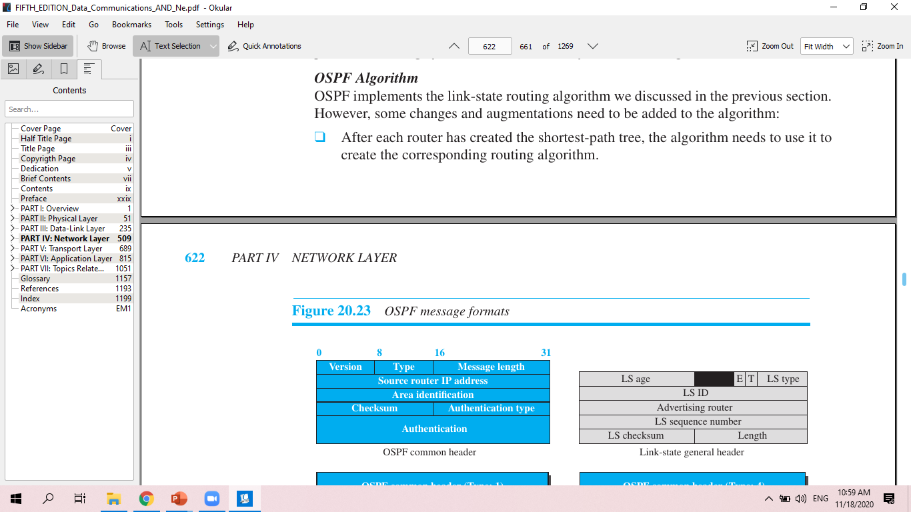
OSPF message format

Slide 12
14.6 PATH VECTOR ROUTING
Path vector routing is similar to distance vector routing. There is at least one node, called the speaker node, in each AS that creates a routing table and advertises it to other speaker nodes in the neighboring ASs..
The topics discussed in this section include:
Initialization
Sharing
Updating

Slide 13
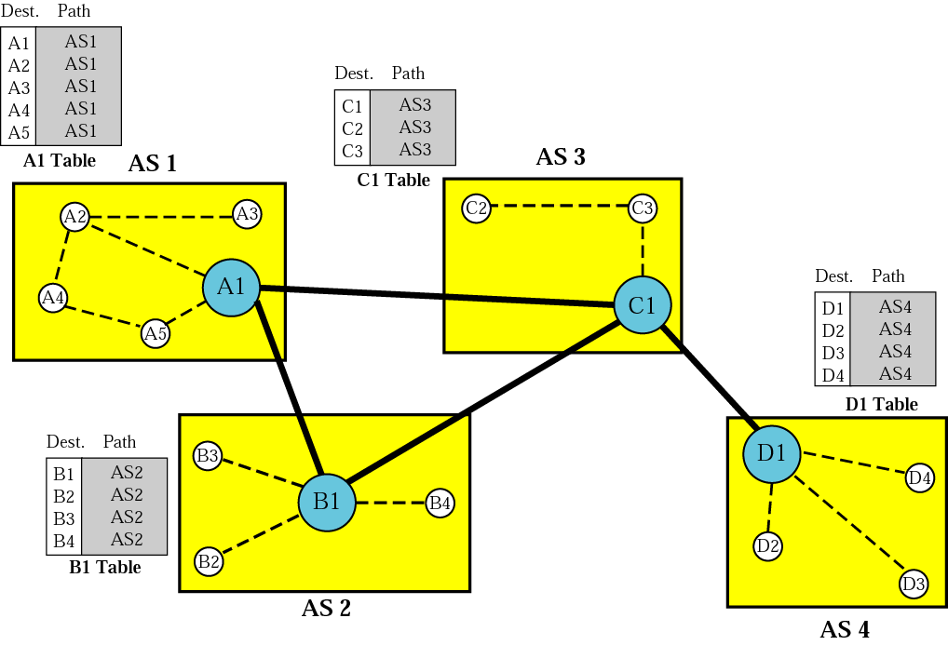
Figure 14.48 Initial routing tables in path vector routing

Slide 14
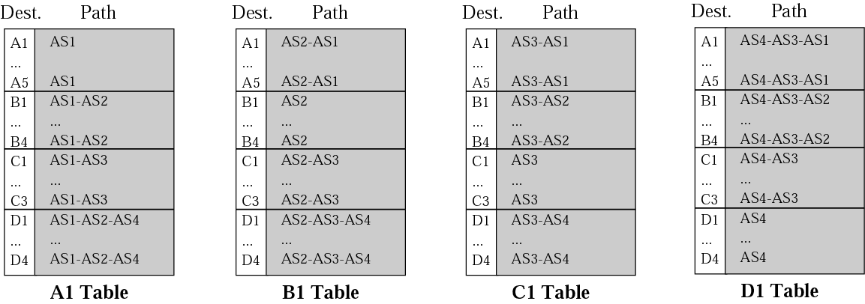
Figure 14.49 Stabilized tables for four autonomous systems

Slide 15
14.7 BGP
Border Gateway Protocol (BGP) is an interdomain routing protocol using path vector routing. It first appeared in 1989 and has gone through four versions.
BGP interconnects three different types of AS:
1. Stub AS, e.g. a corporate network
2. Multihomed AS, e.g. a large corporate network with connections to
multiple ASs, but does not allow traffic to pass thru (transient)
3. Transit AS - one that allows transient traffic, such as an Internet backbone

Slide 16
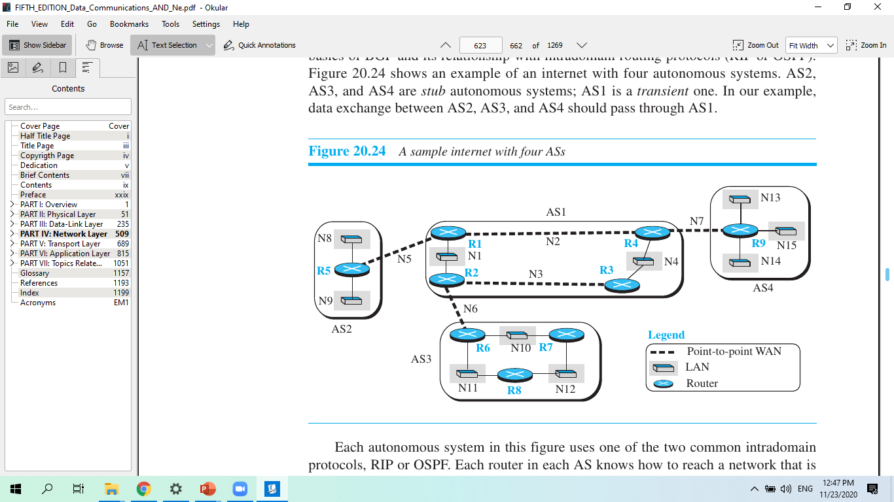

Slide 17
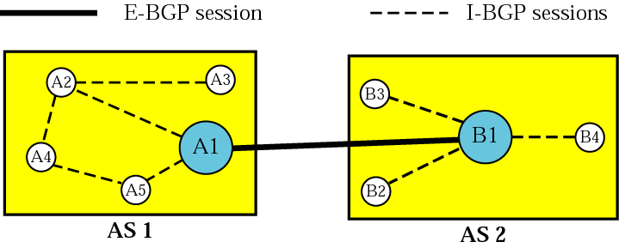
Figure 14.50 Internal and external BGP sessions

Slide 18
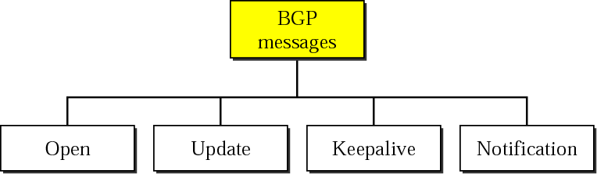
Figure 14.51 Types of BGP messages

Slide 19
BGP Messages
Open Message. To create a neighborhood relationship, a router running BGP opens a TCP connection with a neighbor and sends an open message.
Update Message. The update message is the heart of the BGP protocol. It is used by a router to withdraw destinations that have been advertised previously, to announce a route to a new destination, or both. Note that BGP can withdraw several destinations that were advertised before, but it can only advertise one new destination (or multiple destinations with the same path attributes) in a single update message.
Keepalive Message. The BGP peers that are running exchange keepalive messages regularly (before their hold time expires) to tell each other that they are alive.
Notification. A notification message is sent by a router whenever an error condition is detected or a router wants to close the session.

Slide 20

Note:
BGP supports classless addressing and CIDR.

Slide 21
Note:
BGP uses the services of TCP
on port 179.
RIP uses the services of UDP on port 520.

